Slide 1
Volunteering in the US Brandon Bergerud

Slide 2
Outline
Charity in the United States
Project + Dataset
Visualization Techniques
Demo
Future Directions

Slide 3
Charity by the Numbers
Donations (2017)
$410 billion
Individuals (70%)
Foundations (16%)
Bequests (9%)
Corporations (5%)
General decline in % giving
66% (2000) to 55% (2014)
Nonprofits shifting focus towards wealthier donors

Slide 4
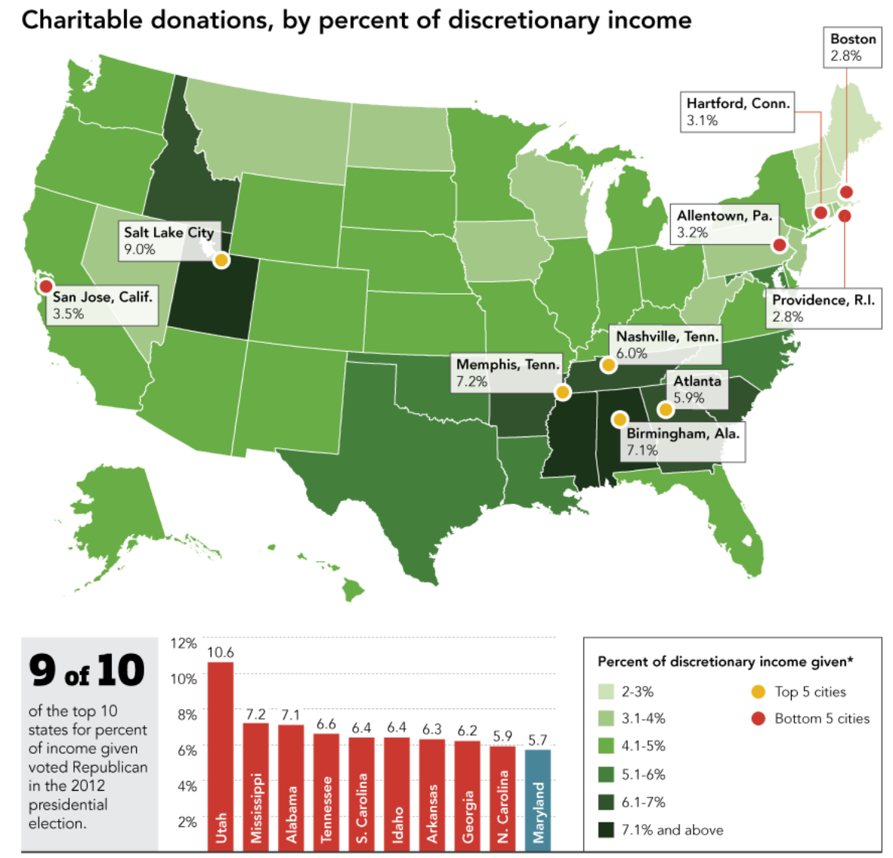
Charity by the Numbers
Donations (2017)
$410 billion
Individuals (70%)
Foundations (16%)
Bequests (9%)
Corporations (5%)
General decline in % giving
66% (2000) to 55% (2014)
Nonprofits shifting focus towards wealthier donors

Slide 5
Charity by the Numbers
Volunteering (2017)
30% of adults
6.9 billion hours
$167 billion
Compared with 2015
25% of adults
7.9 billion hours
$184 billion
Demographic | Volunteer Rate (%)
Men | 26.5
Women | 33.8
Demographic | Volunteer Rate (%)
Generation Y | 26.1
Millennials | 28.2
Generation X | 36.4
Baby Boomers | 30.7
Silent Generation | 24.8

Slide 6
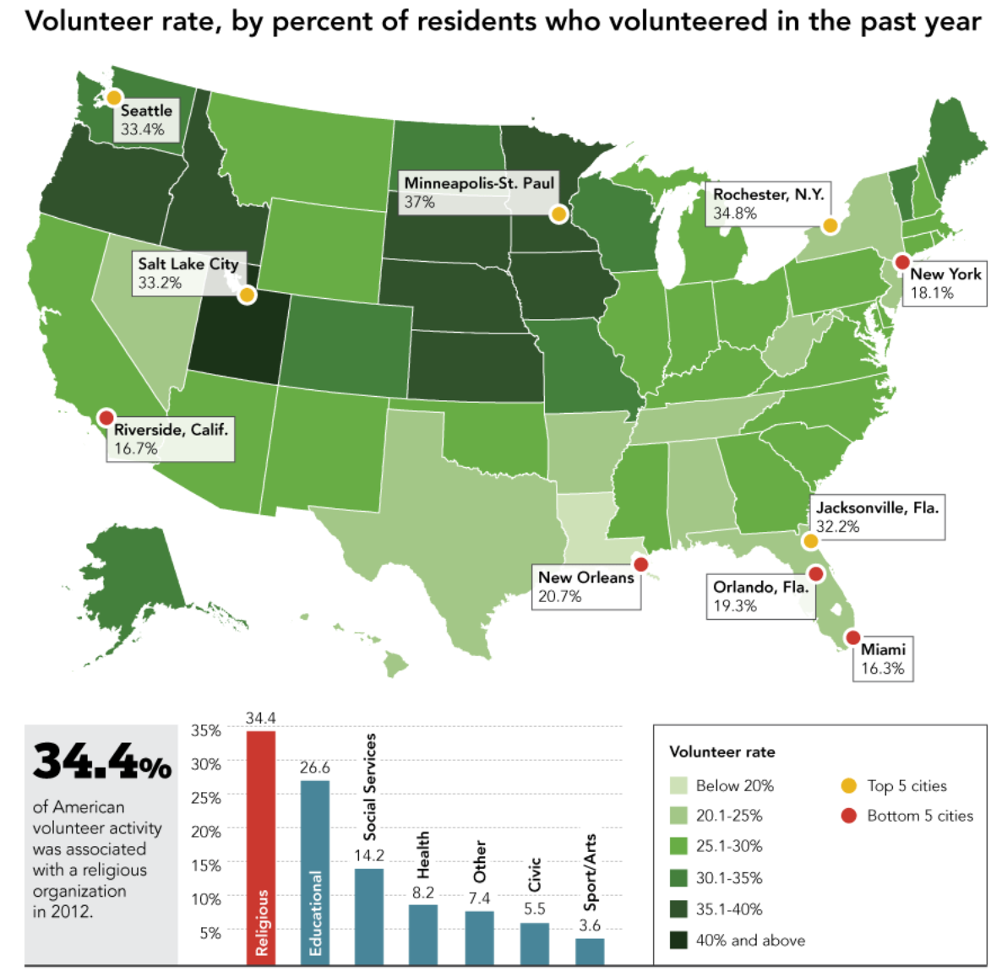
Charity by the Numbers
Volunteering (2017)
30% of adults
6.9 billion hours
$167 billion
Compared with 2015
25% of adults
7.9 billion hours
$184 billion

Slide 7
Project
Volunteering
Organizations, Activities
Spatial Distribution
Demographic Factors
Dataset
Volunteering and Civic Life in America
State / Metropolitan Statistical Area
2017 Dataset
Survey
~60,000 Household / ~100,000 individuals
Response / Sampling Bias

Slide 8
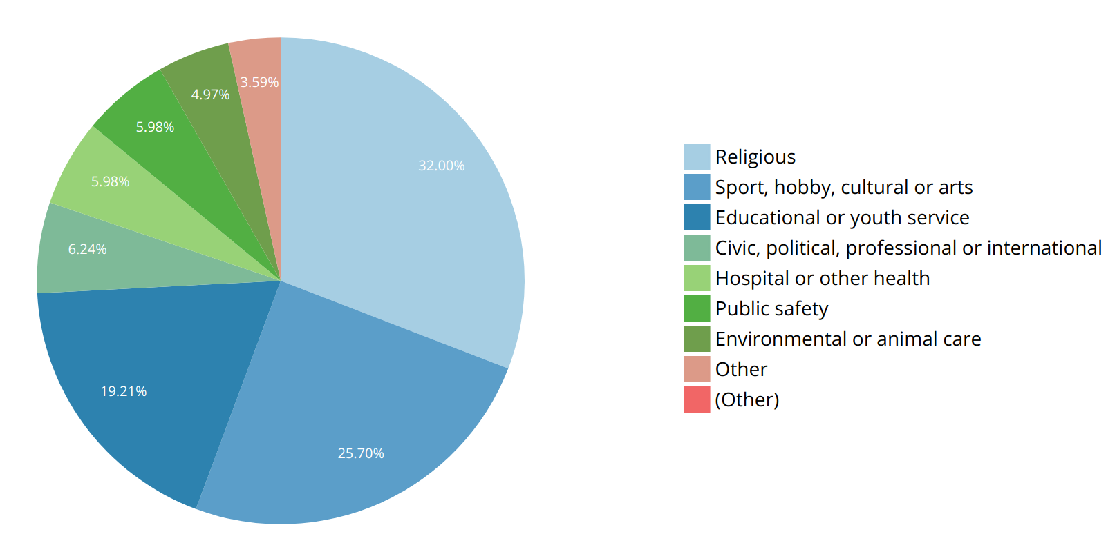
Activities
Organizations
@National Level

Slide 9
Visualization Techniques
Task
Show the spatial distribution of volunteer rates across the US at the state level
Choropleth Mapping
Univariate
Volunteer Activity / Organization
Bivariate
Volunteer Types
Demographic vs. Volunteer ✓

Slide 10
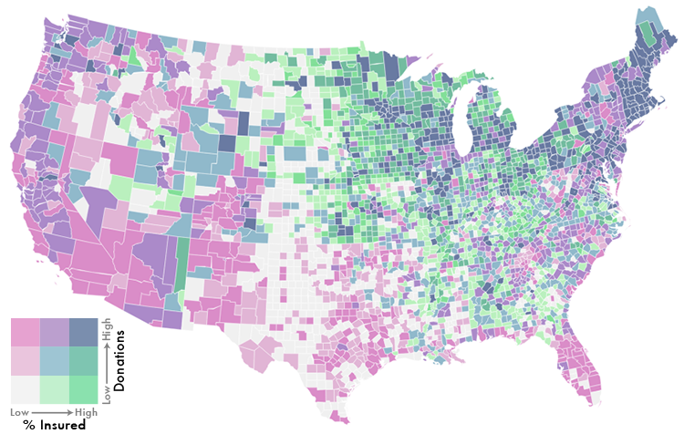
Visualization Techniques
Task
Show the spatial distribution of volunteer rates across the US at the state level
Choropleth Mapping
Univariate
Volunteer Activity / Organization
Bivariate
Volunteer Types
Demographic vs. Volunteer ✓

Slide 11
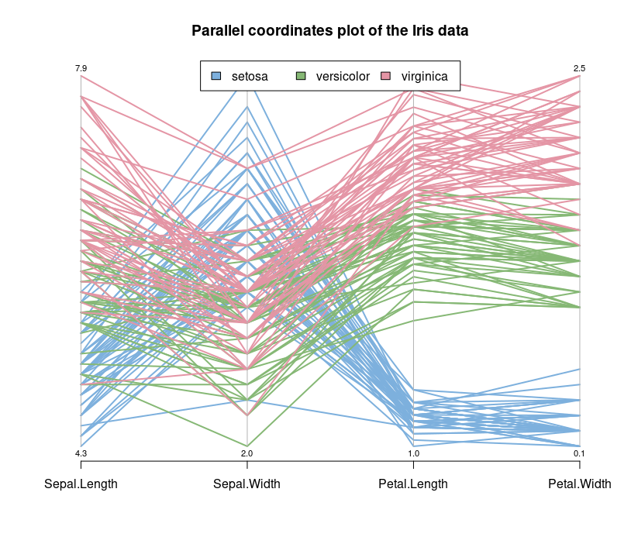
Visualization Techniques
Task
Show how the volunteer rates are distributed among the different activities & organizations
Options
Parallel Coordinate Plot
Pie Chart
Radar Chart

Slide 12
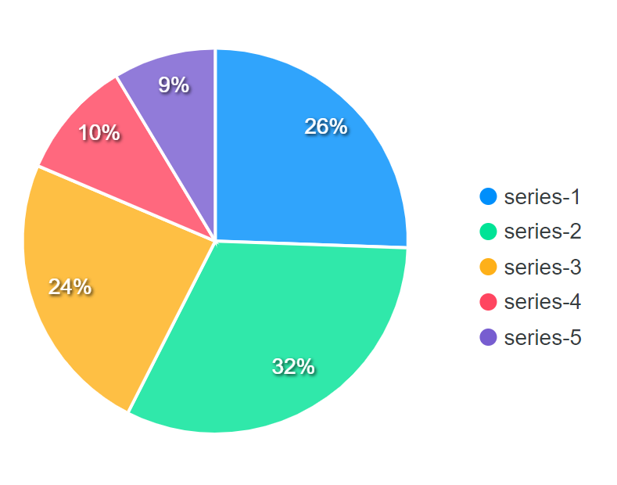
Visualization Techniques
Pie Chart
Limited to a single state at a time
Activities don’t add up to 100%
Parallel Coordinate Plot
Did in lab
Compare across states (cluttered)
Radar Chart ✓
Plot all state data
Highlight indicated state

Slide 13
Visualization Techniques
Pie Chart
Limited to a single state at a time
Activities don’t add up to 100%
Parallel Coordinate Plot
Did in lab
Compare across states (cluttered)
Radar Chart ✓
Plot all state data
Highlight indicated state

Slide 14
Visualization Techniques
Pie Chart
Limited to a single state at a time
Activities don’t add up to 100%
Parallel Coordinate Plot
Did in lab
Compare across states (cluttered)
Radar Chart ✓
Plot all state data
Highlight indicated state

Slide 15
Visualization Techniques
Task
Show the relationship between the demographic variable and the volunteer rate
Scatterplot
x = Demographic Variable
y = Volunteer Rate

Slide 17
Future Directions
Choropleth Maps
Option to choose breaks, e.g.
Equal Interval
Quantile
Natural
Manual

Slide 18
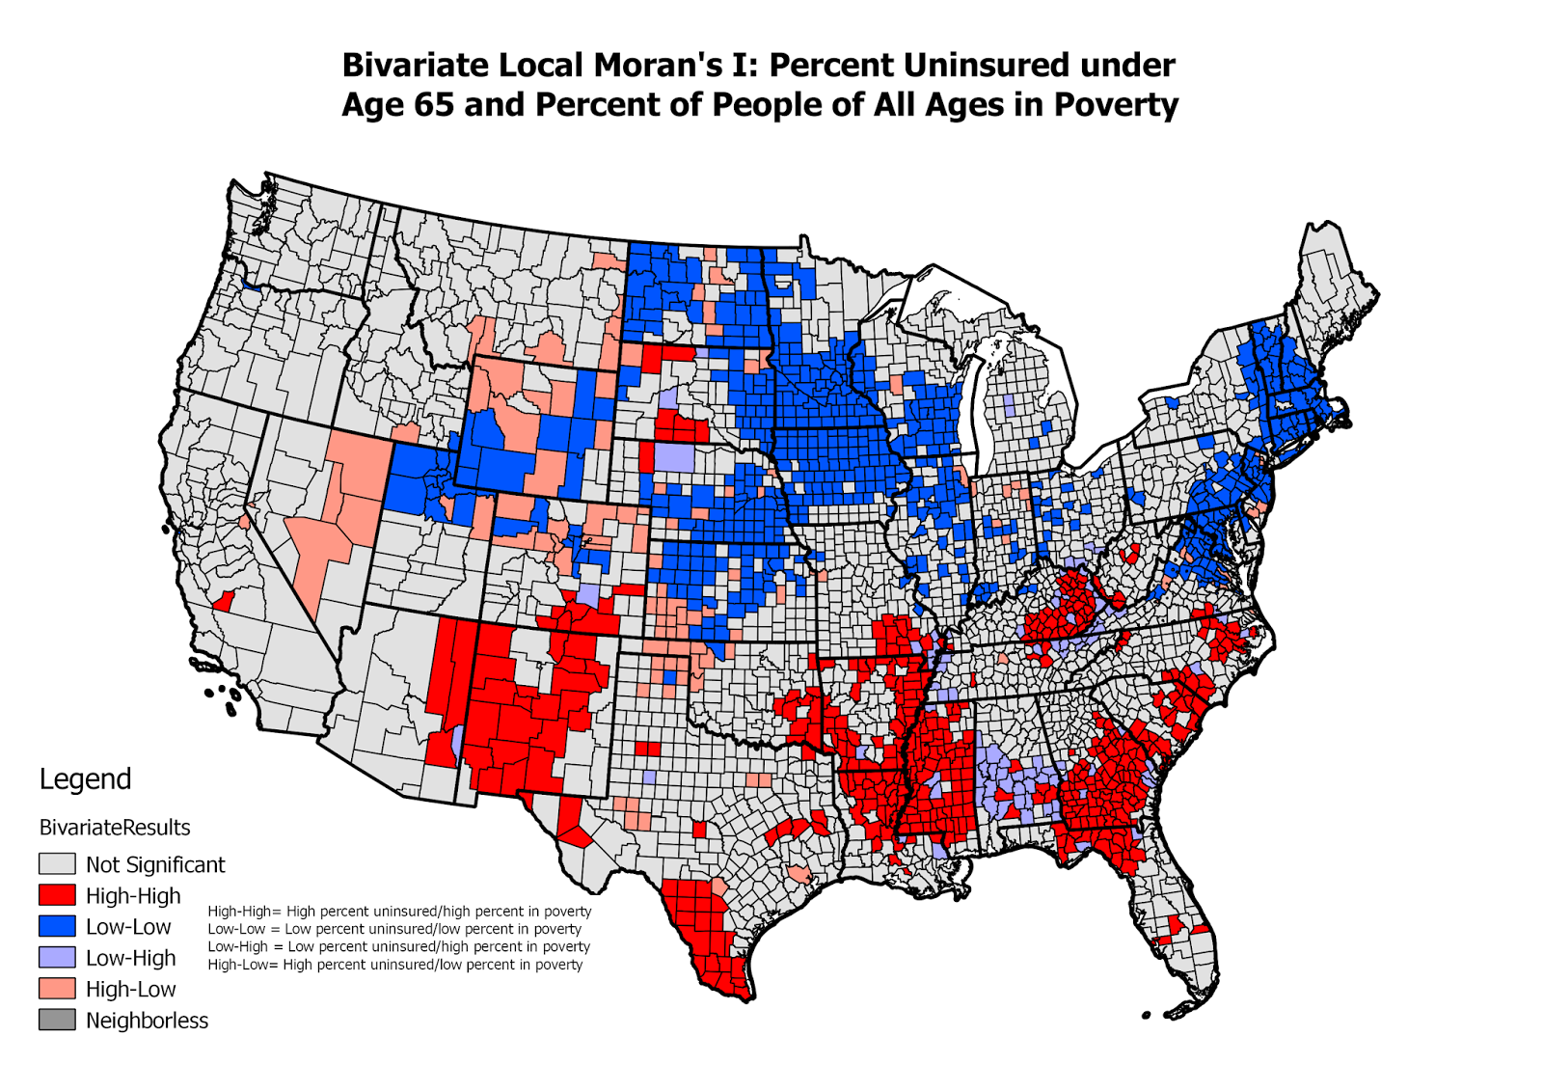
Future Directions
Local Moran’s I
Identifies spatial outliers
Issues
Tedious in ArcMap
Map for each activity / organization
Join state names
Python scripting?

Slide 19
Future Directions
Metropolitan Statistical Areas
Advantages
Smaller Units
Less loss of information
Disadvantages
Longer rendering time (simplify polygons?)
Less border sharing (Moran’s I)

Slide 20
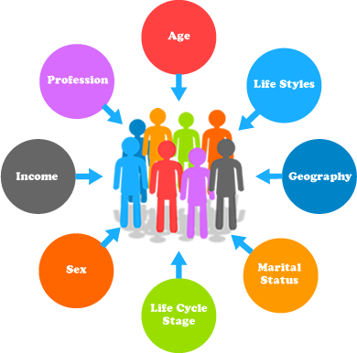
Future Directions
Explore Additional Data
Demographic
Age / Sex
Survey responses
Charity
Donations
Changes over time

